Slide 1
School Cafeteria inspection
Mindy Huie

Slide 2
Introduction
This data is from the annual cafeteria inspection conducted within current active operating school cafeterias within the public, private and parochial schools within New York City.
The inspections must adhere to the NYC food and Safety regulations set forth by the NYC health code article 81.

Slide 3
Data Sources
Data Rows/ Columns
22 Columns
24,550 Rows
Sources
NYC Open Data
Link
https://data.cityofnewyork.us/api/views/9hxz-c2kj/rows.csv

Slide 4
Methodologies
Used Python for data cleaning and removed data not needed for analysis.
Used python libraries: pandas numpy
Visualizations: bar graphs

Slide 5

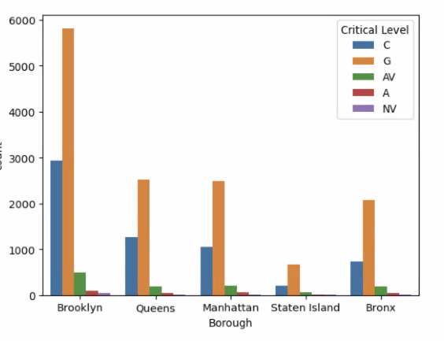
NYC Borough Compare
Violation Types
C- Critical
G- General
A & AV- Admin Violation
NV- Nutrition Violation
TV-Tobacco Violation
Source: NYC Open Data
Overall, Brooklyn has the highest violation types compared to the other Boroughs, at [9402], with General Violations being the highest violation at 5821.

Slide 6
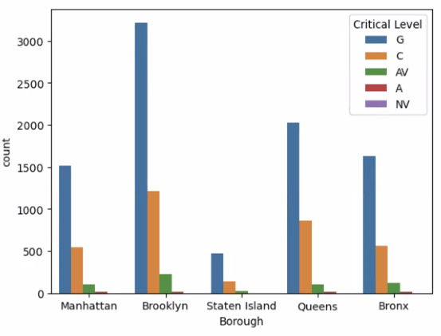
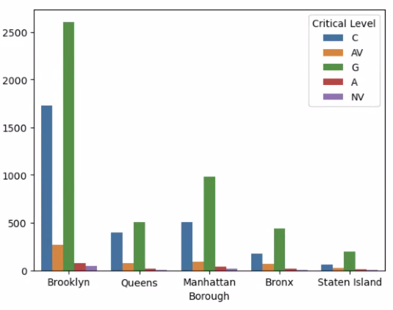
NYC Dept. of Education vs Non-NYC Dept.of Education
Violation Types
C- Critical
G- General
A & AV- Admin Violation
NV- Nutrition Violation
TV-Tobacco Violation
NYC Dept. Of Education Violations
Non-NYC Dept. Of Education Violations
Source: NYC Open Data
Overall, NYC Dept. of Education has the highest violations at 12,879, with General Violations being the highest.
Overall, Non- NYC Dept. of Education has the highest violations at 8,398 with General Violations being the highest.

Slide 7
Findings & Conclusion
From the data I analyzed my findings are that NYC Dept. of Education schools have higher violations compared to Non- NYC Dept. of Education sectors.
From the data I analyzed overall, Brooklyn has the most violations out of all the boroughs.

